Slide 1
Instruction that Works: Direct Instruction
Staff Development Day
9-16-15

Slide 2
Learning Objective
At the end of this class, teachers will be able to identify components of direct instruction that lead to effective teaching and learning.

Slide 3
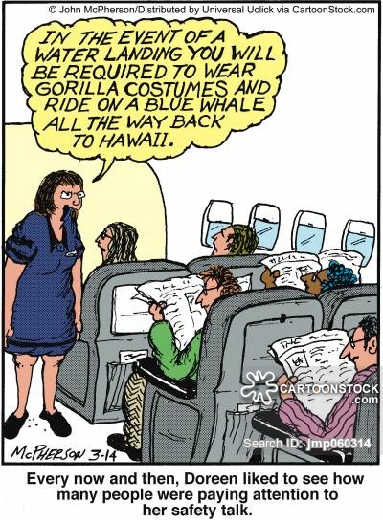
STUDENT ENGAGEMENT

Slide 5
Information Processing Model
The information processing model is based on brain research that explains how information is stored in long term memory then retrieved.

Slide 6
Dale’s Cone of Experience

Slide 7
Direct Instruction – What is it?
Direct instruction is a research-based collection of instructional practices combined together to design and deliver well-crafted lessons.
Research shows that teacher-centered direct instruction is more effective and efficient to teach students something new.
Project and inquiry teaching methods can be also useful in addition to guided instruction.

Slide 8
Student Engagement
Cognitive (Interesting)
Emotional (Fun, Safe)
Behavioral (Attention)

Slide 9
Which strategy works best?
Short-term memory – 30 seconds:
Call in emotion!
Notes:
Stimuli that trigger fight-or-flight responses get our attention first, followed by those with emotional weight. Students must feel safe and emotionally engaged before the next step of learning can occur. This also confirms the value of including an emotional hook at the launch of a lesson.

Slide 10
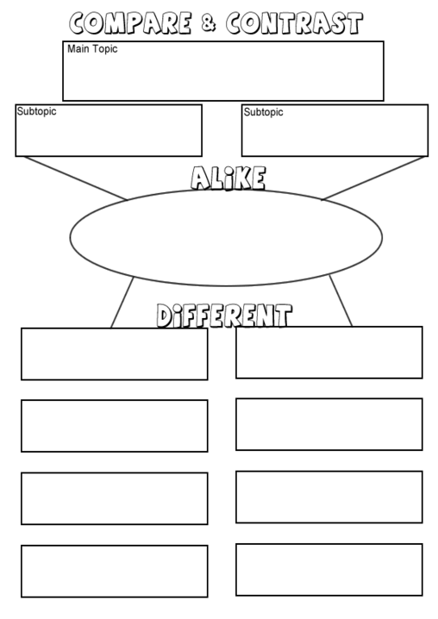
What strategy works best?
Working memory – 20 minutes before it goes away or goes into long-term memory
Nonlinguistic representations, such as graphic organizers, are useful at this point.
Notes:
Working memories only hold up to seven bits of information at a time, so we shouldn’t introduce too much at once. Help students cluster concepts into larger concepts or main ideas, chunking information into shorter segments for processing inbetween.

Slide 11
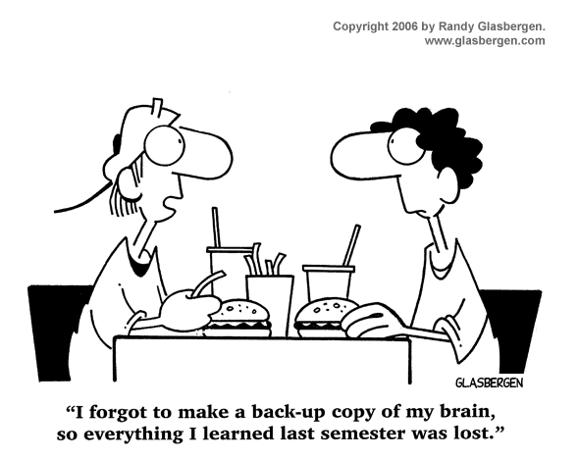
What strategy works best?
Long-term memory: It’s there! For a looooong time!
Repetition and rehearsal are what determines movement into long-term memory.
Notes:
Personal meaning helps students move learning into long-term memory. Rehearsal shouldn’t be rote (memorization) but elaborative. Elaborative rehearsal:
Summarizing learning, engaging in reciprocal teaching, making predictions, generating questions about learning

Slide 12
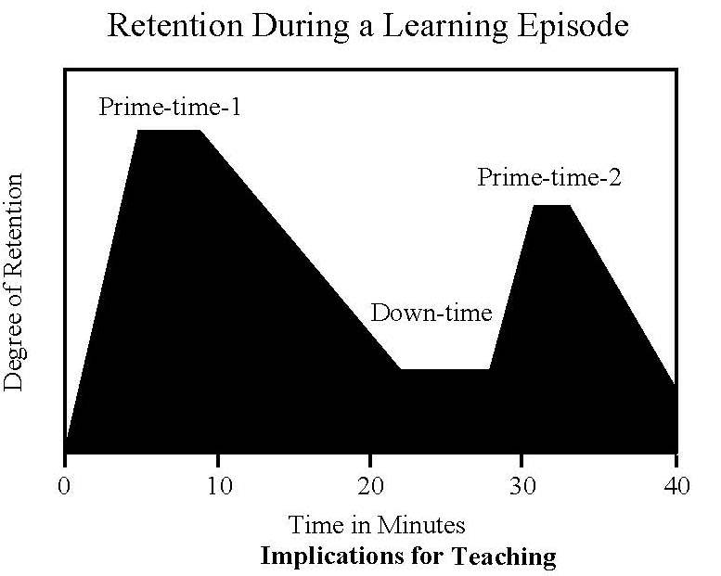
How do we help students pay attention?
Movement
Brain breaks (10 minutes)
Understanding the primacy/recency effect

Slide 13
Active Student Engagement
Pair Share
Use of whiteboard
Choral response
Non-volunteer response
Note-taking
Note-making
Note-interacting
Oral Reading
Highlighting/Underlining
Reading with a pencil
Non-verbal responses
Use of manipulatives
Complete sentence response
Finding textual evidence
Writing on a graphic organizer
Justification
Tracking
Attention signal responses

Slide 14
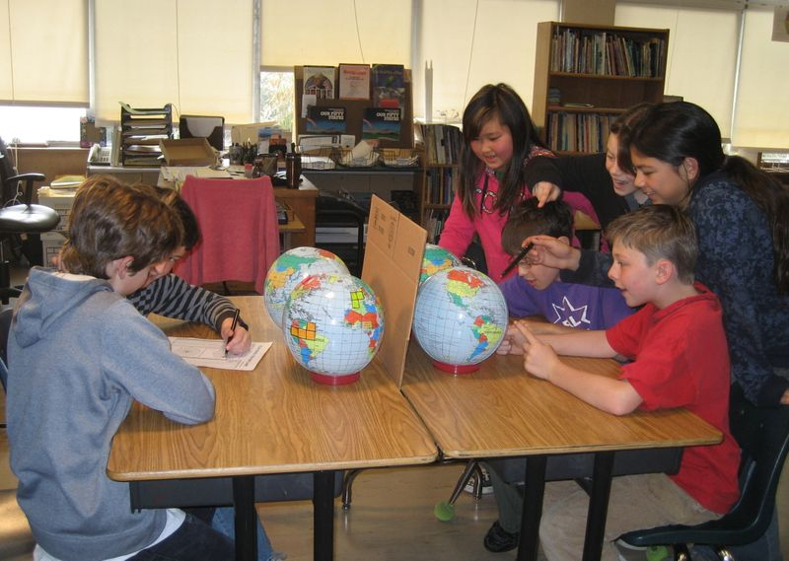
Active Student Engagement
DOING, SAYING, OR PRODUCING

Slide 15
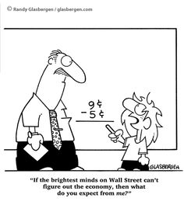
CHECKING FOR UNDERSTANDING

Slide 16
CHECKING FOR UNDERSTANDING
Definition:
The teacher continually verifying
that students are learning
what is being taught
while it is being taught

Slide 17
Why is CFU Important?
It is real-time information that allows the teacher to pace the lesson.
It allows the teacher to provide examples and re-teaching in direct response to students’ ability to answer questions.
It allows the teacher to confirm students can do independent practice before it is assigned.
It makes the classroom more interactive, improving student engagement.
“Practice makes perfect permanence.”

Slide 19
TAP(WB)PLE
Consider, between pair share and pick a non volunteer, having students write on their white boards for reinforcement of learning and so they have something to reference during non-volunteer response time.

Slide 20
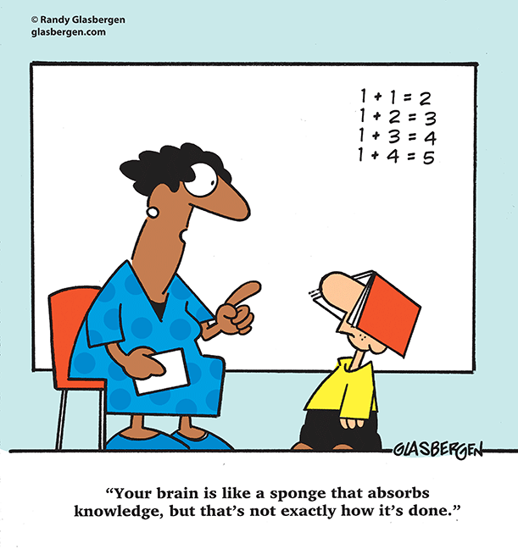
THE BIG THREE
WHOLE CLASS
WAIT TIME
RANDOM
NON-VOLUNTEERS
(at least THREE!)
Notes:
The question must be presented to the entire class.
You must provide wait time before selecting a student to respond. This is so all students can think of an answer even if they are not called upon.
Always call on random non-volunteers. This is the only way you can measure if everyone is learning.

Slide 21
How do we choose non-volunteers?
Popsicle sticks
Index cards
Playing cards
Ping pong balls
Student job
Stickpick (iTunes App $2.99)
Class Dojo
WAIT 8-10 SECONDS

Slide 22
Effective Feedback
Echo
Explain
Elaborate
Notes:
Echo: If there is a correct answer, repeat. Explain (re-explain) when students are incorrect. CFU rule: If two students in a row can’t answer the question correctly, it’s time to reteach.
DON’T let students off the hook! No students should say “I don’t know.”
Elaborate: Don’t echo a tentative or partially correct response – instead, elaborate and paraphrase to reinforce the correct answer to the student who answered and for the benefit of the rest of the students.

Slide 23
WHAT ABOUT VOLUNTEERS?
Notes:
Volunteers can be used to provide additional perspectives but never as CFU
Use them after you’ve called on some non-volunteers
You might want to FAKE THE STICK – You pose a CFU question to the whole class to call on 2-3 random non-volunteers. Then you call on another “non volunteer” of YOUR choosing. This is used to successfully integrate struggling students into classroom questioning AFTER they’ve heard the correct answer a few times OR to give that high achieving student a chance to share their idea.

Slide 24
CFU Techniques that do NOT work
Thumbs up/thumbs down
Volunteer (consider using this for gifted learners and high achievers, to keep them motivated)
Raise your hand if you are confused/if you understand
Choral response – this is an engagement technique, but not a checking for understanding technique
Pair share without calling on non-volunteers
Asking questions BEFORE teaching (this only assesses background knowledge)
Others?
Notes:
Volunteers can be used to provide additional perspectives but never as CFU
Use them after you’ve called on some non-volunteers
You might want to FAKE THE STICK – You pose a CFU question to the whole class to call on 2-3 random non-volunteers. Then you call on another “non volunteer” of YOUR choosing. This is used to successfully integrate struggling students into classroom questioning AFTER they’ve heard the correct answer a few times OR to give that high achieving student a chance to share their idea.

Slide 25
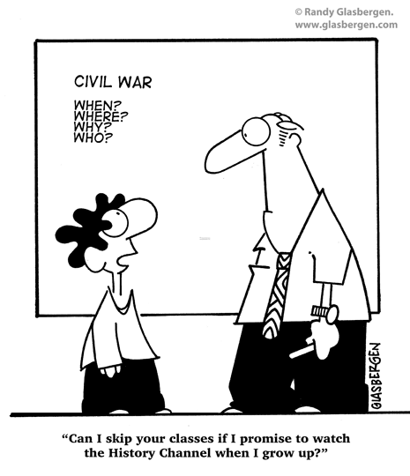
LEARNING OBJECTIVE

Slide 26
LEARNING OBJECTIVE
COMPOSING and PRESENTING
are not the same as
HAVING and POSTING
a learning objective.
*Too often we judge the effectiveness of the learning objective part of the lesson by checking to see if one is posted, rather than observing the PROCESS and PRACTICE of teaching a learning objective.*

Slide 27
Standards vs. Learning Objectives
Standards describe what students are to be taught over the course of a year. They are an end of the year outcome.
A Learning Objective describes what students will learn at the end of a specific lesson as a result of instruction. They are an end of the lesson outcome.
At the end of this class, teachers will be able to identify components of
direct instruction that lead to effective teaching and learning.

Slide 28
Learning Objectives that produce great lessons are not just thrown together. They are carefully planned using specific components.
Learning Objectives Contain:
Skill (measurable behavior) – the VERB
Ex: Add decimals to hundredths, using concrete models or drawings and strategies based on properties of operations.
Concept (main idea) – the NOUN
Ex: Add decimals to hundredths, using concrete models or drawings and strategies based on properties of operations.
Sometimes a Context (restricting condition) – the HOW
Ex: Add decimals to hundredths, using concrete models or drawings and strategies based on properties of operations.
At the end of this class, teachers will be able to identify components of
direct instruction that lead to effective teaching and learning.

Slide 29
Writing Learning Objective Skills
Learning Objectives must contain a measurable skill (verb) such as: identify, calculate, compare, estimate, cite evidence, formulate, analyze, prove.
Non-measurable objectives such as learn, understand, know should not be used because it is difficult to determine whether or not students have successfully completed the objective.
The skill in the Learning Objective must always exactly match what the students will be asked to do on their independent practice. (Remember - it is the desired end of the lesson outcome).
**Bell’s 12 Most Powerful Words**
At the end of this class, teachers will be able to identify components of
direct instruction that lead to effective teaching and learning.
Notes:
Refer to PPT for Bell’s most powerful words

Slide 30
Interacting with the Learning Objective
Interaction is important for student engagement and checking for understanding!
Document Camera / Projector
Power Point presentation
Whiteboard / Sentence Strip
Handout
Choral Response: pronounce academic vocabulary
Pair Share
Gestures
Note Taking: Cue students to write down, underline, highlight, circle important information.
At the end of this class, teachers will be able to identify components of
direct instruction that lead to effective teaching and learning.

Slide 31
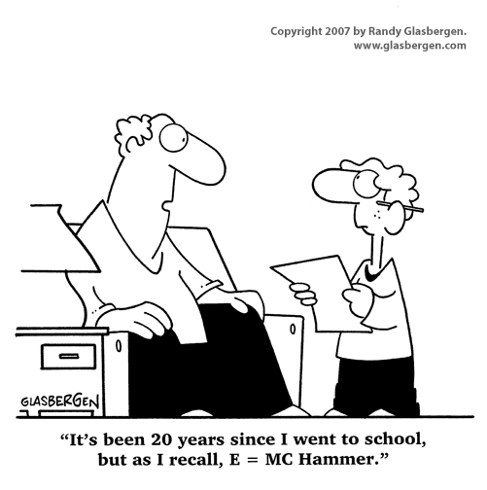
ACTIVATION OF PRIOR KNOWLEDGE (APK)

Slide 32
APK
APK provides a bridge
APK explicitly retrieves pertinent information from long-term memory and places it into working memory.
Notes:
In a direct instruction lesson, Activating Prior Knowledge (APK) is used to provide a connection between something students already know and the new content they are going to learn.
APK explicitly retrieves pertinent information from long-term memory and places it into working memory so students are now consciously thinking about it. The teacher then shows the students how the existing knowledge is related to the new content. Now the new content is easier to learn because there is relevant existing knowledge available on which to connect the new knowledge.

Slide 33
Concept Development
There are two ways to
activate prior knowledge
Universal experience: Activate something from students’ prior life experiences that is related to the new learning
Sub-skill review: Reteach a sub-skill that is needed in the new lesson
At the end of this class, teachers will be able to identify components of
direct instruction that lead to effective teaching and learning.

Slide 34
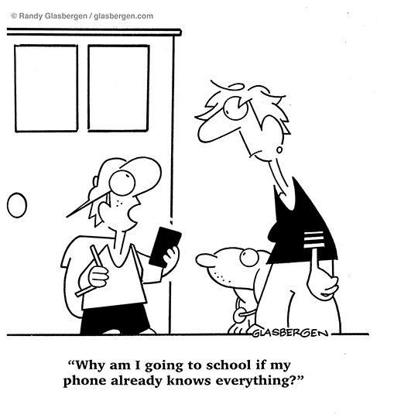
APK Guidelines
Should not take over five minutes.
Can be used before or after teaching the Learning Objective.
Don’t ever use the new vocabulary!
Notes:
Should not take over five minutes.
The bulk of class time should be spent teaching new grade-level content. If APK is too long, students have neither enough instructional time nor repetitions of the new concept to learn it.
Can be used before or after teaching the Learning Objective.
Sometimes, lessons flow better if you start with APK then slide into the LO after the students’ brains are activated.
Don’t ever use the new vocabulary...
in the lesson to activate prior knowledge. An effective APK connects known ideas to the new learning without using any of the new lesson’s vocabulary words.

Slide 35
APK – 3 STEPS
Step #1: APK by reteaching a sub-skill or accessing a universal experience.
Step #2: Facilitate student interaction.
Step #3: Explain the connection to the new lesson.

Slide 36
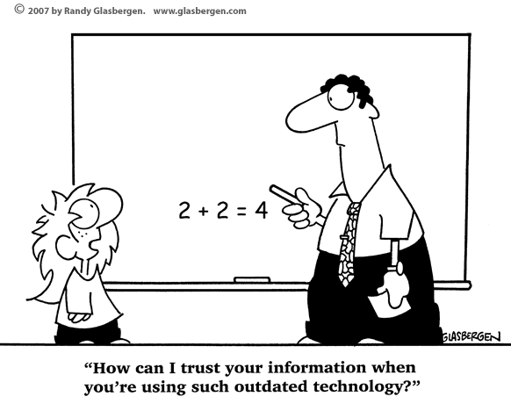
LESSON DELIVERY

Slide 37
LESSON DELIVERY
In direct instruction, there are three methods of delivering content to students:
Explaining
Modeling
Demonstrating
Notes:
In a direct instruction lesson, Activating Prior Knowledge (APK) is used to provide a connection between something students already know and the new content they are going to learn.
APK explicitly retrieves pertinent information from long-term memory and places it into working memory so students are now consciously thinking about it. The teacher then shows the students how the existing knowledge is related to the new content. Now the new content is easier to learn because there is relevant existing knowledge available on which to connect the new knowledge.

Slide 38
CONCEPT DEVELOPMENT

Slide 39
CONCEPT DEVELOPMENT
During Concept Development, you teach the big idea, or the what. It is the main idea of the Learning Objective. It is usually a noun.
During Skill Development, you teach the process, or the how. It is usually the verb.

Slide 40
Concept Development
Examples of concepts
Make inferences using information from the text.
Evaluate an author’s use of persuasive techniques.
Calculate equivalent fractions.
Solve one-step linear equations.
Describe the checks and balances in the U.S. Constitution.
At the end of this class, teachers will be able to identify components of
direct instruction that lead to effective teaching and learning.

Slide 41
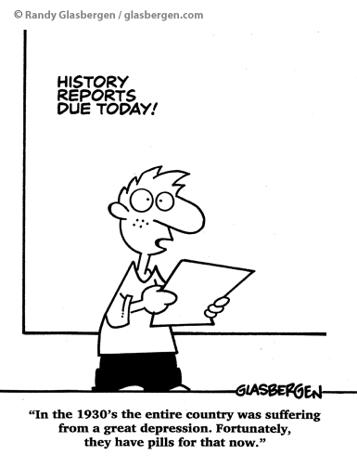
Concept Development
Why is Concept Development important?
Concepts are our foundations.
Generalization occurs.
It’s all about vocabulary!
At the end of this class, teachers will be able to identify components of
direct instruction that lead to effective teaching and learning.
Notes:
Students need a good foundation at the conceptual level so they can apply the concepts they have learned to new situations.
Students internalize the generalization as opposed to learning individual instances.
Students master new academic vocabulary.

Slide 42
Concept Development
What are examples of concept development?
Definition
Examples
Think aloud
Diagrams/
charts
Realia
Memory device
Graphic organizer
Video
Model
At the end of this class, teachers will be able to identify components of
direct instruction that lead to effective teaching and learning.

Slide 43
What are the steps in teaching the concept?
Identify the concept in the LO
Provide a written bulletproof definition or rule
Provide examples and non-examples
Teach by explaining, modeling, or demonstrating
Have students interact with the concept
Provide Checking for Understanding questions
At the end of this class, teachers will be able to identify components of
direct instruction that lead to effective teaching and learning.

Slide 44
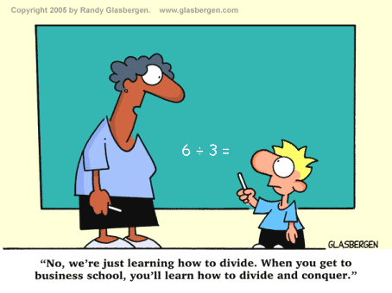
SKILL DEVELOPMENT

Slide 45
What is Skill Development?
Skill Development is when you teach your students how to execute the skill (the verb) in the Learning Objective. You teach students how to APPLY that skill to the concept.
At the end of this class, teachers will be able to identify components of
direct instruction that lead to effective teaching and learning.

Slide 46
EXAMPLES
Compare the American Revolution to the French Revolution
Describe three kinds of rocks.
Identify text written in the sequential order format.
Analyze similes.
Divide 3-digit numbers by 1-digit numbers.
Convert one unit of measurement to another.
Evaluate an author’s use of persuasive techniques.
Build parallel electrical units.
At the end of this class, teachers will be able to identify components of
direct instruction that lead to effective teaching and learning.

Slide 47
STEPS IN SKILL DEVELOPMENT
Identify the skill in the Learning Objective.
Provide a step-by-step process, method, or approach for the students to use.
Model using the steps while solving real problems.
CFU – verify that students can describe how to execute the skill and describe how you solved the problem.
At the end of this class, teachers will be able to identify components of
direct instruction that lead to effective teaching and learning.

Slide 48
WHAT/WHY/HOW
WHAT
What did I do first to solve the problem?
What is the second step?
WHY
Why is that step important?
Why did I subtract 4 from the other side of the equation?
HOW
How did I know if the answer was 12 square feet or 12 square inches?
How do you choose the method to solve a problem?
At the end of this class, teachers will be able to identify components of
direct instruction that lead to effective teaching and learning.

Slide 49
What if it’s not a step-by-step skill? Like: DESCRIBE THE FUNCTION AND STRUCTURE OF THE DIGESTIVE SYSTEM
Teach details by explaining, modeling, or demonstrating
Include mnemonics
Provide CFU questions
At the end of this class, teachers will be able to identify components of
direct instruction that lead to effective teaching and learning.

Slide 50
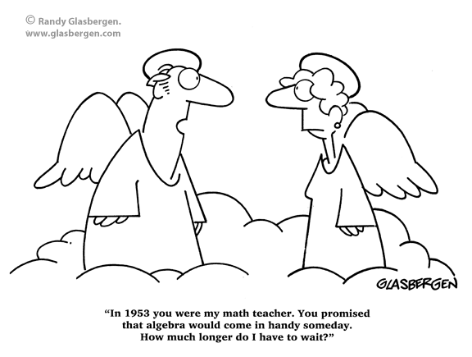
LESSON IMPORTANCE

Slide 51
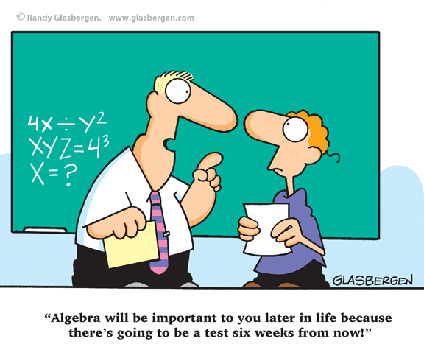
LESSON IMPORTANCE
WHEN DO I TEACH IT? Whenever!
WHAT KINDS OF IMPORTANCE ARE THERE?
Personal importance
Academic importance
Real-life importance
DON’T FORGET TO CFU!
At the end of this class, teachers will be able to identify components of
direct instruction that lead to effective teaching and learning.
Notes:
Students, being able to answer these types of questions about expository text is important. Some of you are getting ready to take the driver’s license written test. That written test asks questions similar to those we are going to work on today.
It’s on the test
Students, photosynthesis is important because it is the source of all the food we eat on the earth.

Slide 52
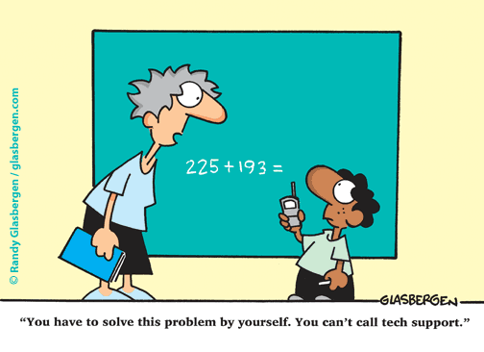
***GUIDED PRACTICE***

Slide 53
GUIDED PRACTICE - SKILL
Guided Practice is only guided if the teacher and students are doing the work AT THE SAME TIME:
I DO the problem
WE DO the problem
YOU DO the problem
WE DO the problem
OR use the Rule of Two:
I DO two sample problems
YOU DO two problems
WE DO those same two problems
At the end of this class, teachers will be able to identify components of
direct instruction that lead to effective teaching and learning.

Slide 54
GUIDED PRACTICE - CONCEPT
Guided Practice is only guided if the teacher and students are doing the work AT THE SAME TIME:
Structure of digestive system: As a class, WE draw and label organs in the digestive system
Inferences: Teacher think-aloud leads to student think-aloud with teacher guidance
How characters and setting contribute to plot line: Class discussion and whole class note-making or graphic organizer completion
At the end of this class, teachers will be able to identify components of
direct instruction that lead to effective teaching and learning.

Slide 55
GUIDED PRACTICE
THIS IS THE KEY ELEMENT OF A DIRECT INSTRUCTION LESSON. WITH CONTINUOUS ENGAGEMENT AND CHECKING FOR UNDERSTANDING, THIS IS HOW YOU UNCOVER STUDENT UNDERSTANDING AND LEARNING. YOU GRADUALLY RELEASE STUDENTS TO MORE INDEPENDENCE.
At the end of this class, teachers will be able to identify components of
direct instruction that lead to effective teaching and learning.

Slide 56
CLOSURE

Slide 57
CLOSURE
Closure is NOT
Reminding the students of what they learned
Cooperative
A time for students to ask questions
Teacher-led conversation

Slide 58
CLOSURE
Closure IS
The last thing you do before independent practice
A time when students INDEPENDENTLY prove that they learned what they were supposed to learn (concept and/or skill in the LO)
The doorway to providing interventions
Evidence students are prepared for homework and independent practice OR next lesson
80-100% of your students need to be successful before moving on!

Slide 59
INDEPENDENT PRACTICE

Slide 60
INDEPENDENT PRACTICE
Must match LO
Must match guided practice examples
Must match the homework
Should yield high achievement if the lesson was taught effectively
Helps students repeat the newly learned concept and skill for memory transfer
Can help you meet with struggling learners right after Closure

Slide 61
RESOURCES
Oakdale website: full lesson videos broken apart by lesson component http://www.oakdale.k12.ca.us/IS4
Explicit instruction website – partial lesson videos http://explicitinstruction.org/
SUSD teacher binder

Slide 62
COMING UP…
Staff Development Days:
10/21 – (Tentative) Lesson design - guided practice
EDI Book Study:
Cohort 1 - 3:10-5:00 - Nine meetings
Afternoon release model?
Online community model?

Slide 63
The idea of what makes an effective
instructor has changed!
“A good teacher has changed from ‘one who explains things so well that students understand’ to ‘one who gets students to explain things so well that they can be understood.’” –Steven C. Reinhart

